Slide 1
Red letter days
By Rohan Ghag VII

Slide 2
Red letter days
For this even I have taken into consideration many different trip ideas for the student body and have shortlisted one event for each category and shortlisted further to pick one specific trip.
The one picked was from the water category, where the 20 students can go white water rafting together for £980
Also I plan to send the 20 students to a dinning hall, which is one fixed menu, so it is treated as a fixed cost. The dinning hall is called the secret ingredient, and for all 20 of them to go there costs £300.

Slide 3
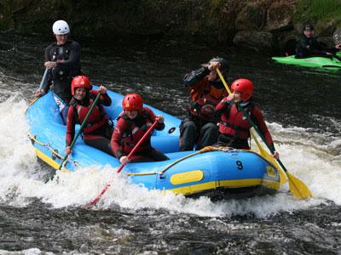
Trip out White water rafting
Location: London
Price: £980 (20 students)
Category: Water
Description:
This event is an adventurous/water activity, where all of the students can have a turn going through a natural flow of rapids. It is located in London and the students will get there themselves, then they will drive together in a club van and raft down white water streams. It is important that the students can swim however. (if they can’t then their screwed.)
This event was one of the most cost effective trips, and provides a great value for money.

Slide 4
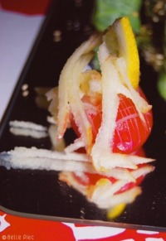
Dinning The Secret ingredient
Location: Stoke Newington London
Price:£300 (20 students) (£15 each)
Description
This dinning hall provides food for all of the students having a fixed menu, one for meat eaters and one for vegetarians both have the same price.
This site was chosen as it is located in London and it is one of the cheapest around that area. The cheapest being a salad bar may be slightly unappetizing for them.

Slide 5
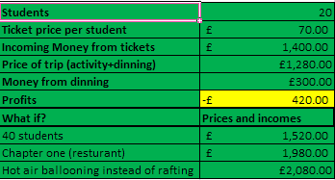
Accounts
The cost for all students to for on trip: £1280
As people are driving there themselves there are no coach costs.
People pay for their own food so an extra £15 is charged , making £300 of dinning money.
With the price of tickets being £70, if 20 students attend then we get a £420 profit, and it will allow room for profit even if less than 20 arrive.
From tickets and dinning :£1700

Slide 6
Break even analysis
Break even after 16 students
With a ticket price of £70.00 each
Break even with £80 profit

Slide 7
Additional costs or changes
If we take 40 students at the same price of £70 per ticket, we get a profit of: £1820
The lowest ticket price which we could offer is at £45 leading to a profit of about £80.
One other trip event could be going hot air ballooning which would cost: £2,080

